Slide 1
German Traffic Sign Classification - Waymo Expansion Plan
by Jorge Velasquez

Slide 2
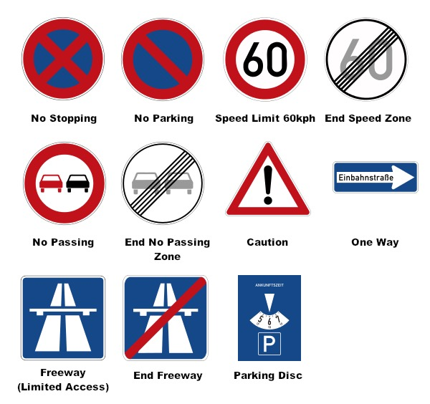
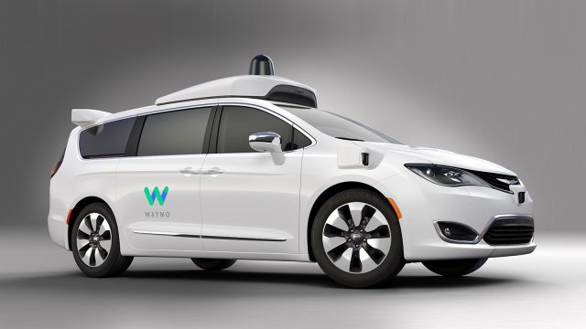
Background
German investors are looking to increase competition in the autonomous driving industry in Germany. They have approached Waymo to expand its autonomous driving fleet to Germany. Waymo has agreed to take on the challenge.

Slide 3
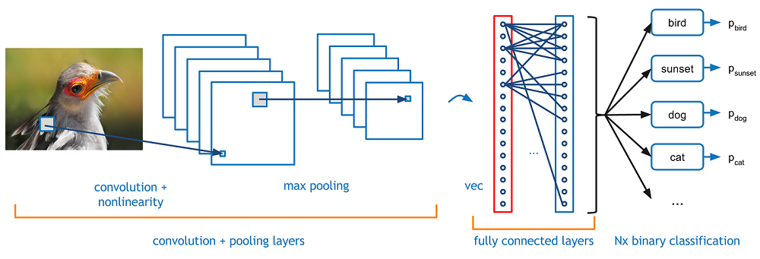
Problem Statement
Build a new robust image classification model that achieves high accuracy on all 3 datasets provided by the German investors. My goal is to build a convolutional neural network (CNN) to classify if a traffic sign image is 1 of 43 classes.

Slide 4
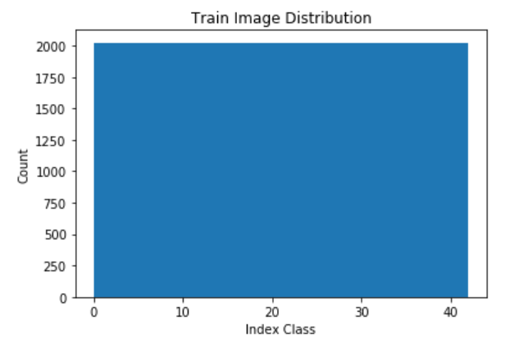


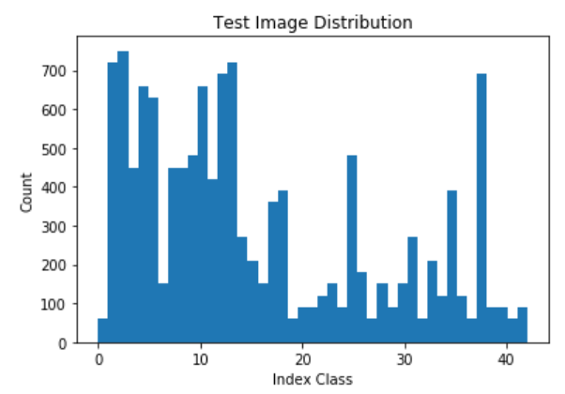
Data Summary
Each data point consists of 3 matrices for RBG channel pixels and is 1 of 43 classes.
Training set ~87K images with equal representation of classes.
Validation set ~4K images with different distribution to training distribution.
Test set ~13K images with different distribution to training distribution.

Slide 5
Data Preprocessing
Pixel Scaling Scale pixels between 0 and 1.
Mean and Standard Deviation Normalization 1. Find mean and standard deviation of train data.
2. Take data and subtract the mean and divide by standard deviation to normalize.

Slide 6
Model Background

Slide 7
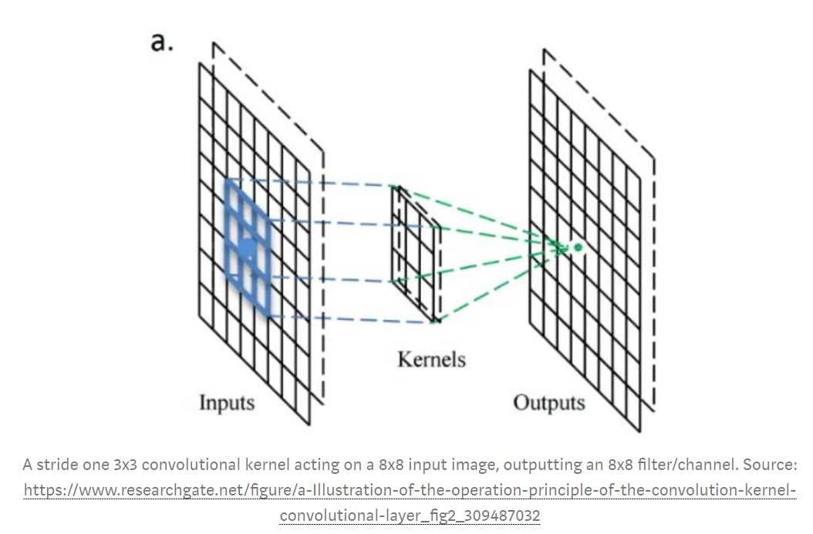
Convolutional layers extract the high-level features such as edges, from the input image. The 1st ConvLayer captures the Low-Level features such as edges, color, gradient orientation. In later layers, the model adapts to the High-Level features.

Slide 8
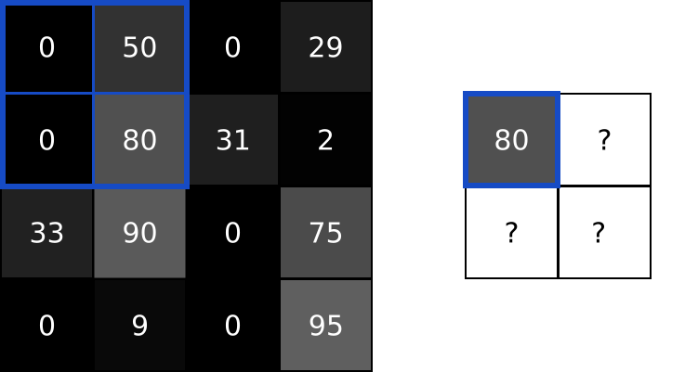
Pooling layers reduce the spatial size of the Convolved Feature. They decrease the computational power required to process the data through dimensionality reduction. Furthermore, it’s useful for extracting dominant features.

Slide 9
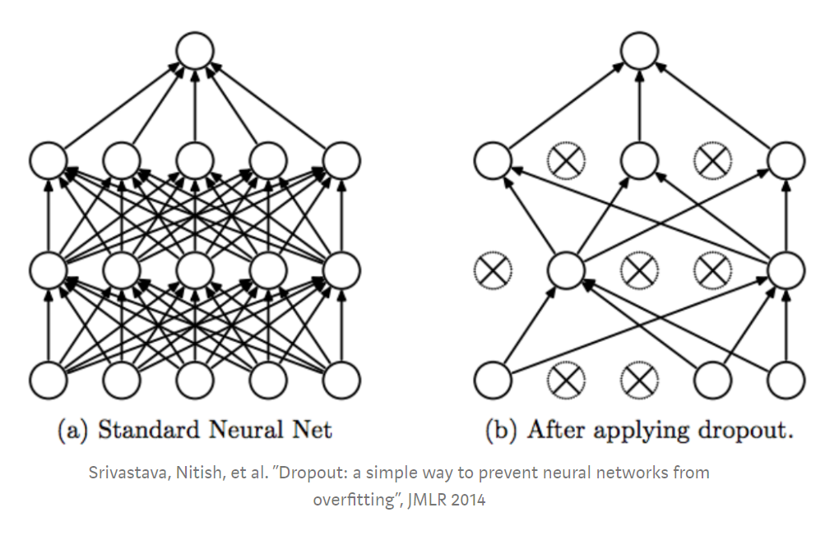
Dropout layers force a neural network to learn more robust features that are useful in conjunction with many different random subsets of the other neurons. During training, some number of layer outputs are randomly ignored or “dropped out.”

Slide 10
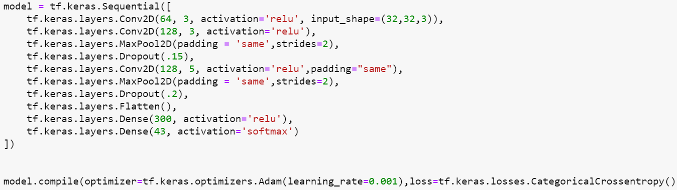
CNN Model
https://github.com/jvel76/git/blob/master/German%20Traffic%20Sign%20Classification%20v2.ipynb

Slide 11
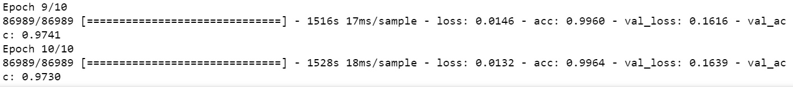
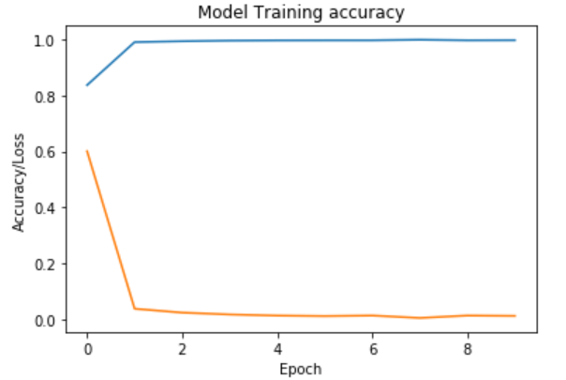
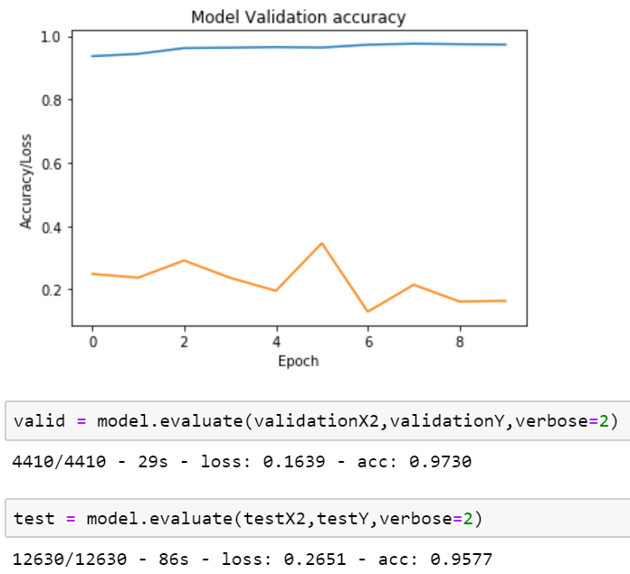
Model Results

Slide 12
Next steps? PCA and Image Whitening.

